Slide 1

YILPORT OSLO
TRUCK VISITING INFO

Slide 2
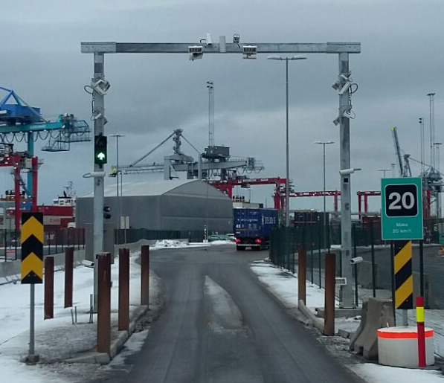
YILPORT OSLO – Terminal Entry , Inbound Portal
Maximum height: 5,6 Meter
Maximum width: 3,5 Meter
Speedlimit: 20KM/t
Tail-gating is prohibited.
Nb: follow the light signals!
For OOG transportation surpasing the Max Height/Width, please call us in order to arange alternative entry route: +47 46835324

Slide 3
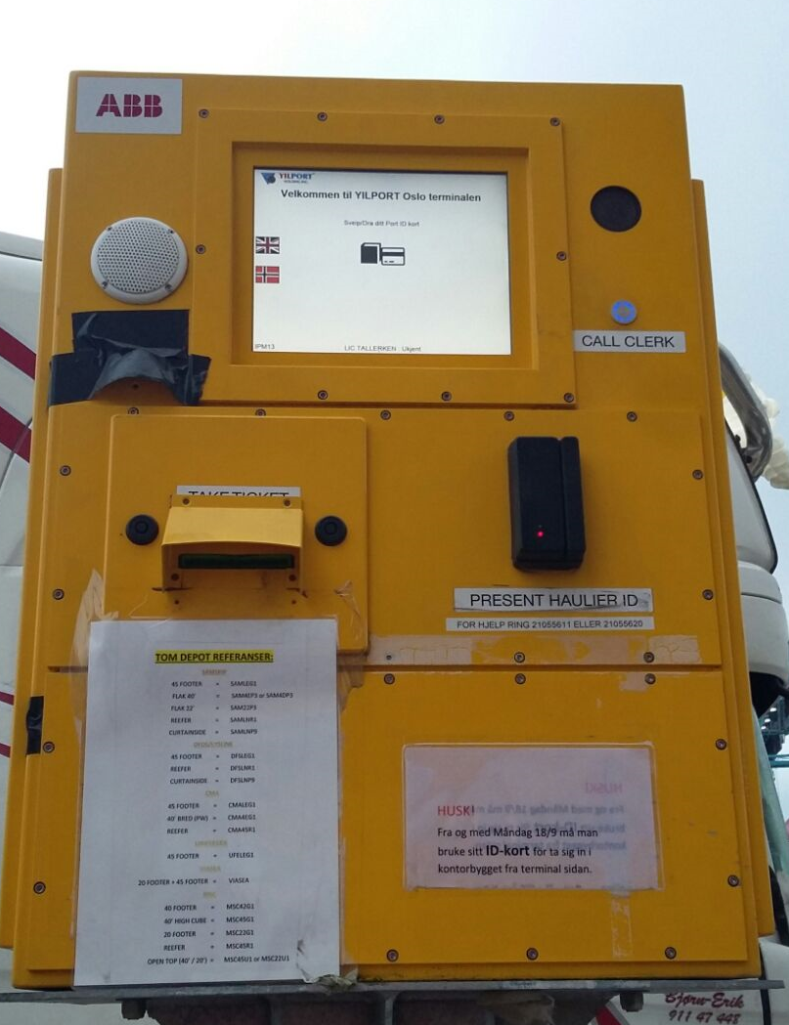
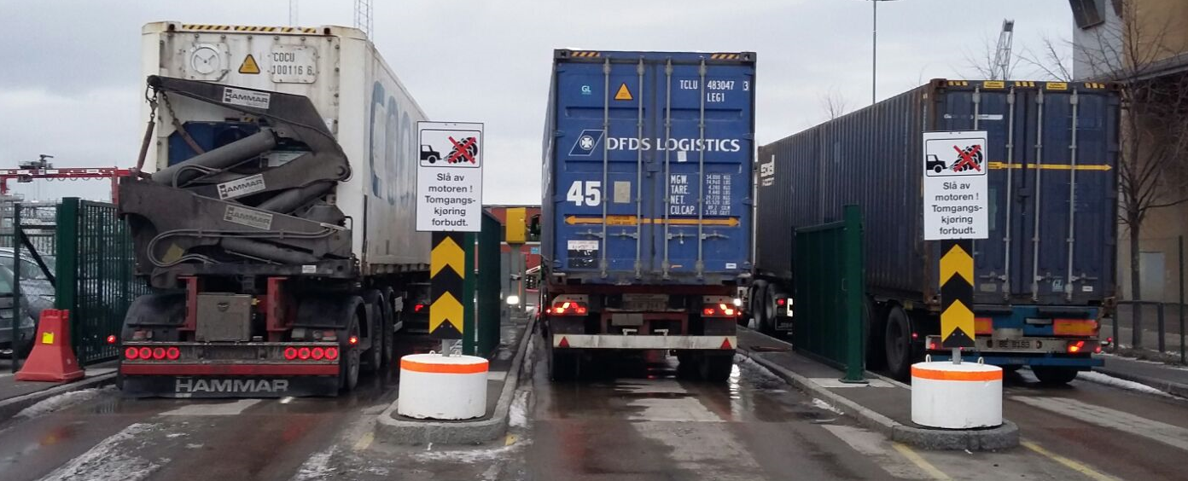
YILPORT OSLO – Gate In Stage
Drive up to the Kiosk in one of the 3 inbound & lanes and turn the off engine.
Identify yourself by Swiping your ID card to start registrating gate transactions. If you do not have an ID card contact the the gate clerks in order to Register/sign in.
ID Card must be visible at all times inside of the terminal.
Our gate staff is available to assist if problems occur at the kiosk (gate-in stage). if any information is missing/incorrect after completing the gate stage, press the «Call clerk» button to the right of the kiosk screen.

Slide 4
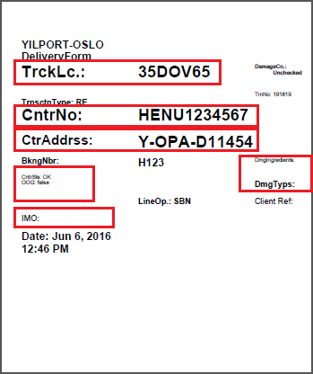
YILPORT OSLO – Kiosk Ticket Explained
License plate number.
Unit Number.
Location of assignment:
Eks; D11454 – Stack D1 Location 14 Position5.4
OOG information:
IMDG information:
Damages:
Nb: If any information on the ticket is incorrect, the gate clerks must be contacted before entering the terminal.

Slide 5
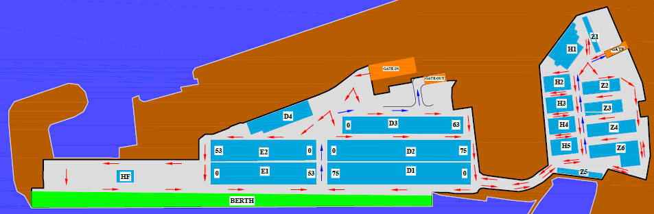
YILPORT OSLO – Driving Pattern
GATE IN
GATE OUT

Slide 6


YILPORT OSLO – Safety By Choise, Not by Chance
Speed Limit 30 KM inside terminal
No use of phone !

Slide 7

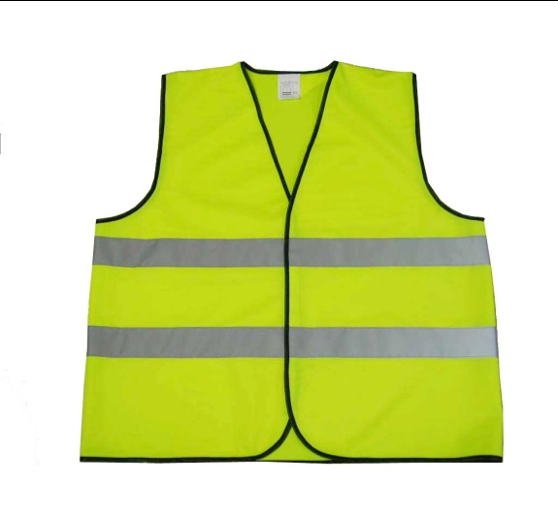

YILPORT OSLO – Safety By Choise, Not by Chance
Mandatory Safety Gear Inside Terminal
Hard Hat
Reflective Safety Jacket
Safety Shoes

Slide 8
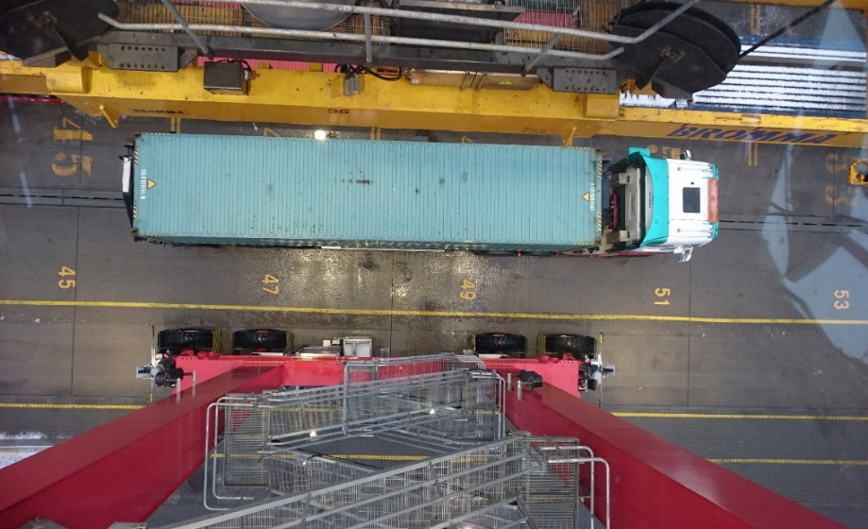
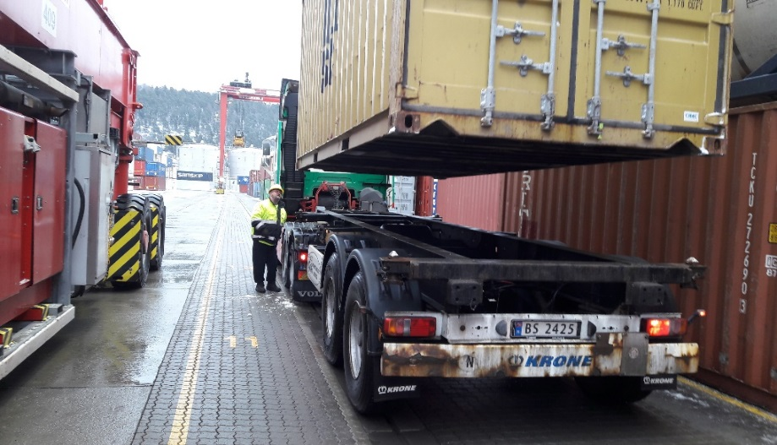
YILPORT OSLO – Safety By Choise, Not by Chance
Receipt / Delivery of Containers Under RTG Crane
Always park straight in truck lane
Licence plate has to be visable for RTG driver, on roof/back end of cabin
Insure twist locks are correctly unlocked before delivery
Locking devices must be in such condition that prevents their twisting during receipt/delivery
Stand outside truck in front of chassis between truck and crane
Always be visible for crane driver at all times
Help crane driver by using signals

Slide 9
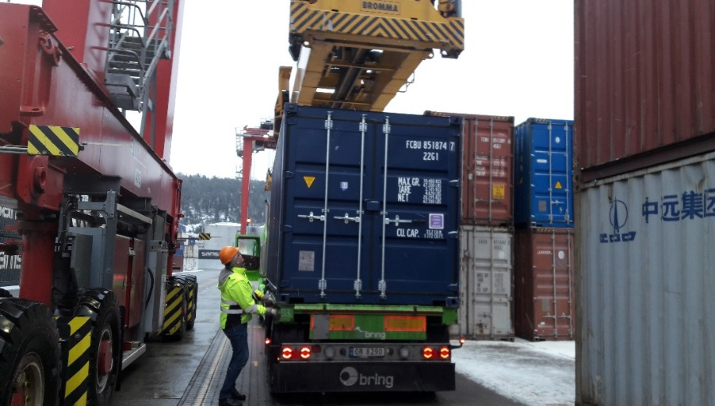
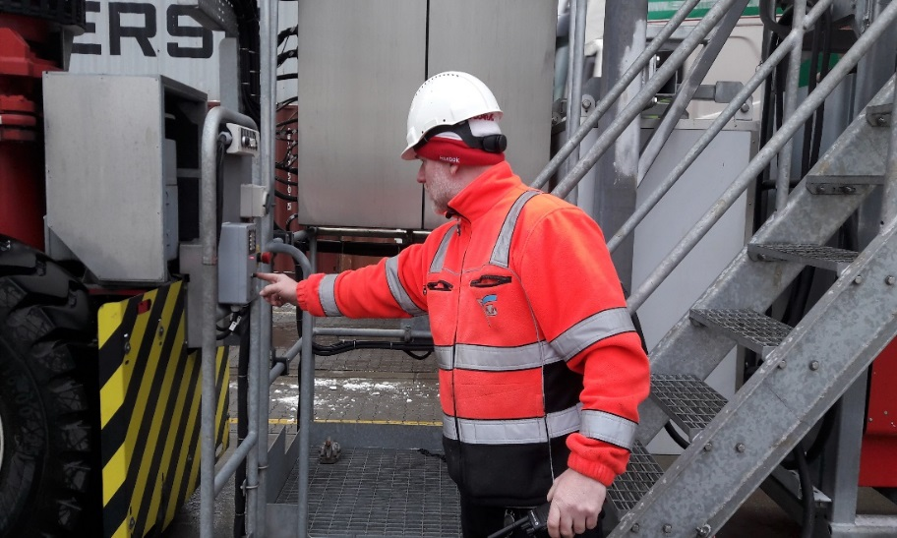
YILPORT OSLO – Safety By Choise, Not by Chance
Receipt / Delivery of Containers Under RTG Crane
Never lock twist locks before spreader is clear of container when receiving unit
If communication with RTG driver needed, use intercom

Slide 10
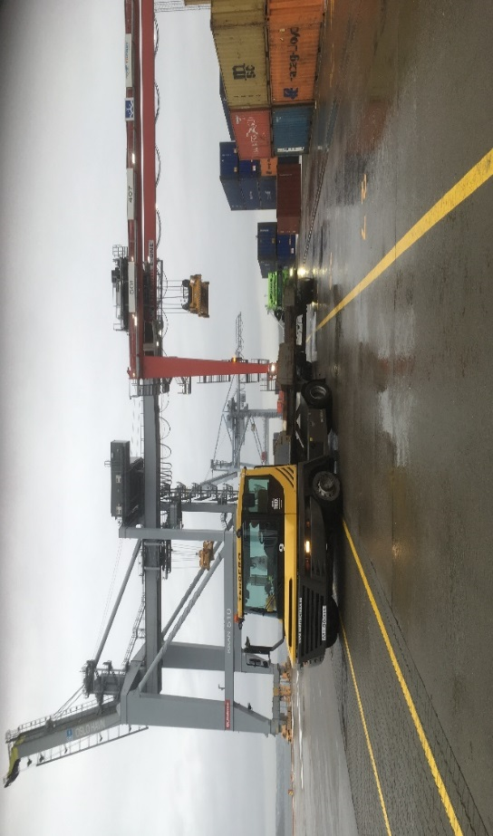
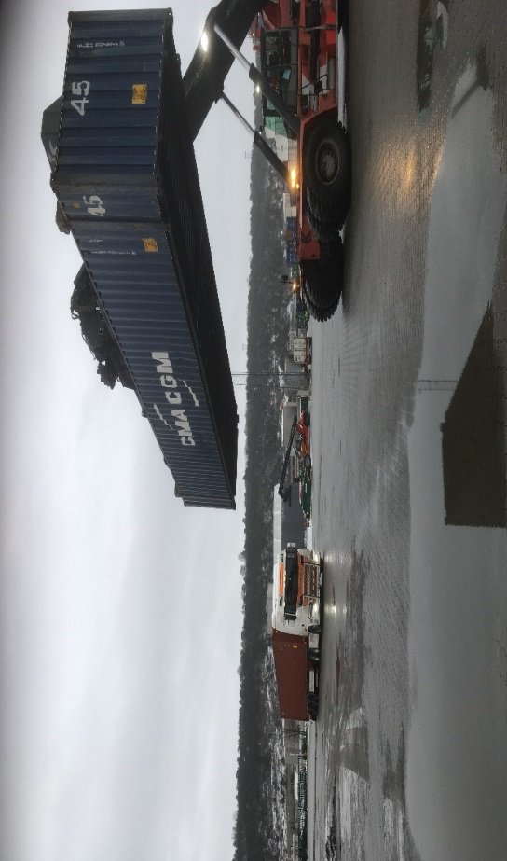
YILPORT OSLO – Safety By Choise, Not by Chance
Receipt / Delivery of Containers Under RTG Crane
Never cross RTG lane without enough space towards RTG to avoid dangerous situations.
Always stop for Yilport Equipment
No passing under elevated container

Slide 11
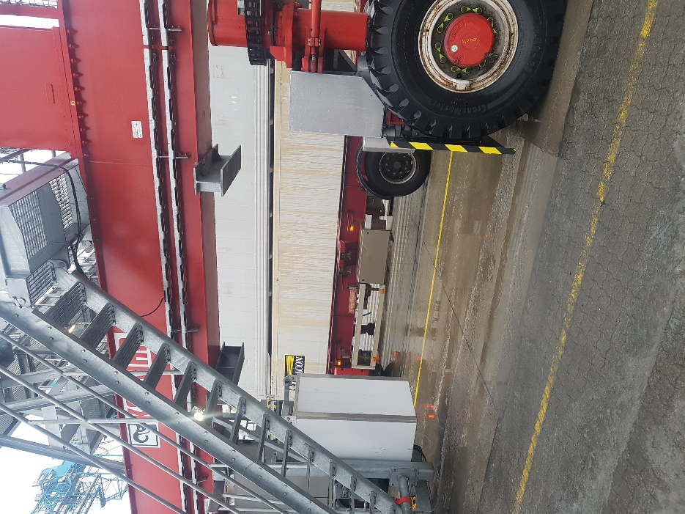
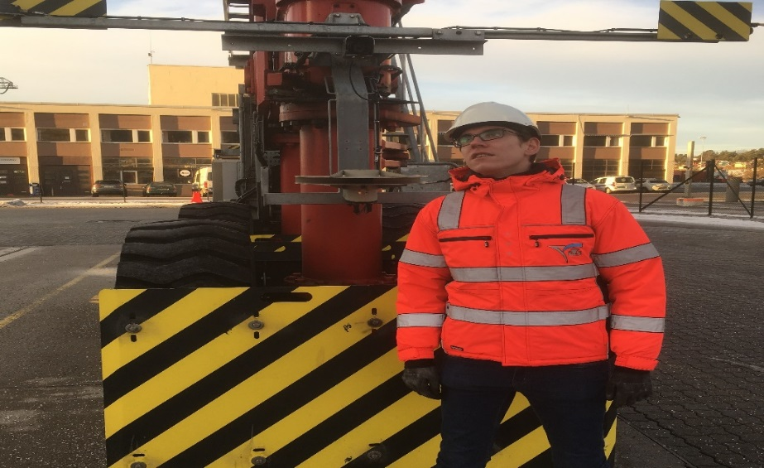
YILPORT OSLO – Safety By Choise, Not by Chance
Receipt / Delivery of Containers Under RTG Crane
Don`t go under RTG crane!
No entrance inside RTG stack without permission
Never stand in RTG lane
When passing RTG lane, keep at least 5 meter distance from crane

Slide 12
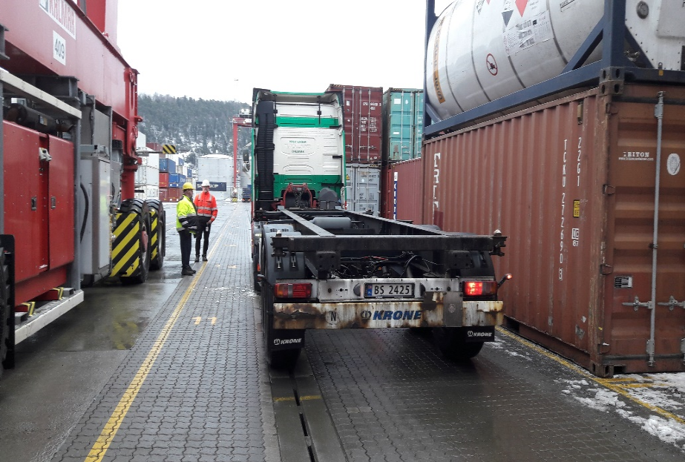
YILPORT OSLO – Safety By Choise, Not by Chance
Receipt / Delivery of Containers Under RTG Crane
New truck drivers must be accompanied by an experianced driver before he/she enters the terminal alone
Passengers are not allowed, must be dropped of at the gate

Slide 13
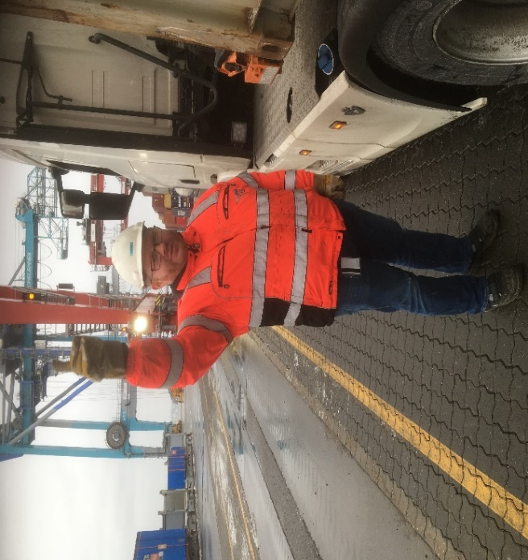
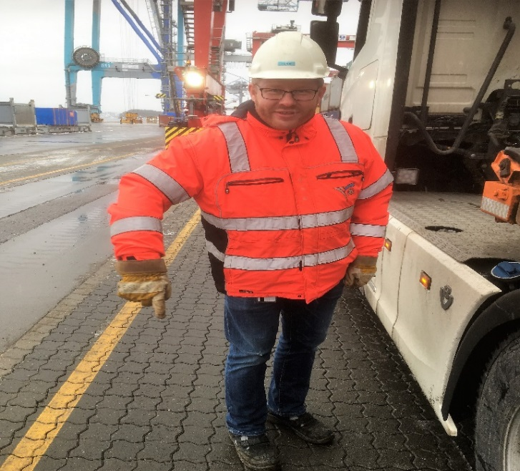
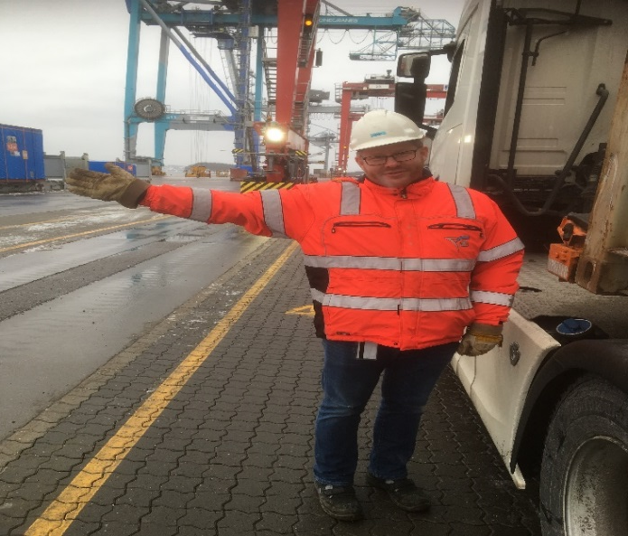
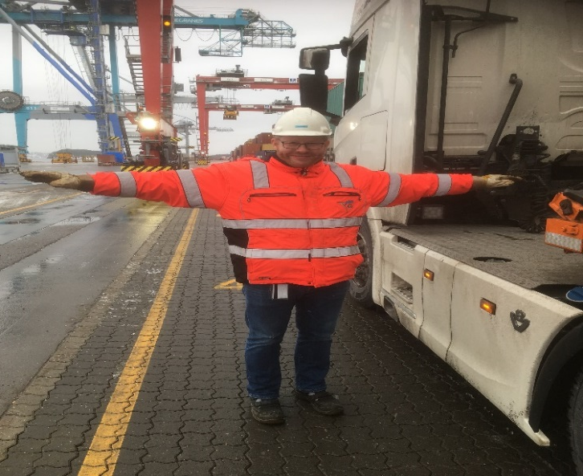
YILPORT OSLO – Safety By Choise, Not by Chance
Signals
Up
Down
Direction
Job Done
Direction

Slide 14
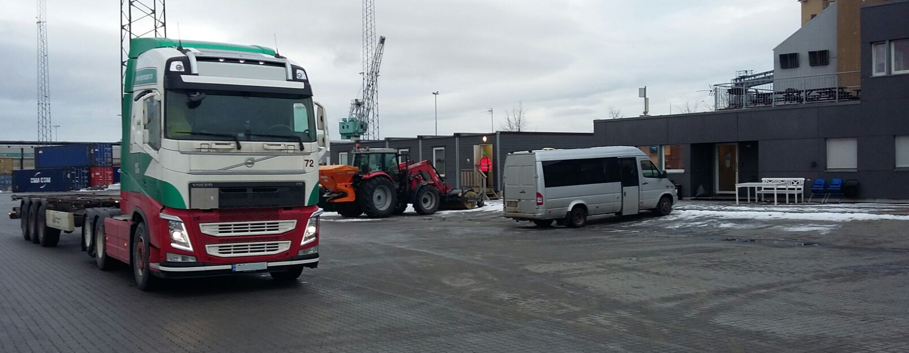
YILPORT OSLO – Safety By Choise, Not by Chance
Before Leaving the Terminal All Transporters Must Check
That the unit number is correct and matches the ticket from the gate in stage.
That the unit has no un-noted damages
That the seal number on the unit is correct according to documentation (for import units)
That the overall height/ widht is within the outbound portal limitations (Same as inbound portal).
That the unit is placed and secured properly on chassis.
If there is any deviation from the check list above, contact the gate clerks and report the issue before exiting the terminal.

Slide 15

YILPORT OSLO
INFORM YILPORT STAFF IMMEDIATELY IF :
You see any accidents.
You see staff or transporters acting in violation of Yilport Oslo’s safety/security guidelines.
Suspicious activity that deviates from normal conduct/operations.
Failure to comply with Yilport Oslos safety/security instructions may result in temporary or in worst case permanent denial of access to the terminal.

